Slide 1


K-Means Clustering
Wake Forest
School of Business
_______
BAN 6025

Slide 2
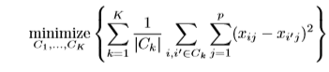
K-Means Clustering
Given the number of clusters, k, the k-means algorithm consists of four steps:
Select initial centroids at random
Assign each object to the cluster with the nearest centroid
Compute each centroid as the mean of the objects assigned to it
Repeat previous 2 steps until no change:

Slide 3
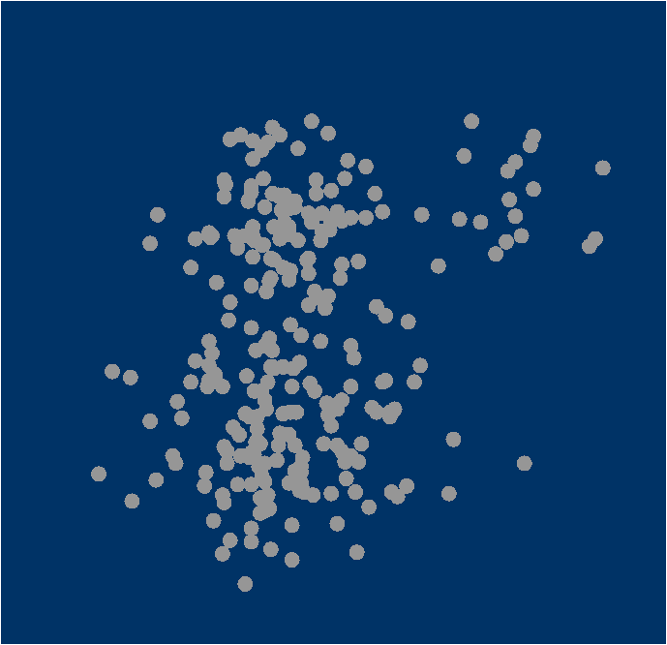
k-means clustering algorithm
Training Data
1. Select inputs.
2. Select k cluster centers.
3. Assign cases to closest center.
4. Update cluster centers.
5. Re-assign cases.
6. Repeat steps 4 and 5
until convergence.

Slide 4
k-means clustering algorithm
Training Data
1. Select inputs.
2. Select k cluster centers.
3. Assign cases to closest center.
4. Update cluster centers.
5. Re-assign cases.
6. Repeat steps 4 and 5
until convergence.

Slide 5
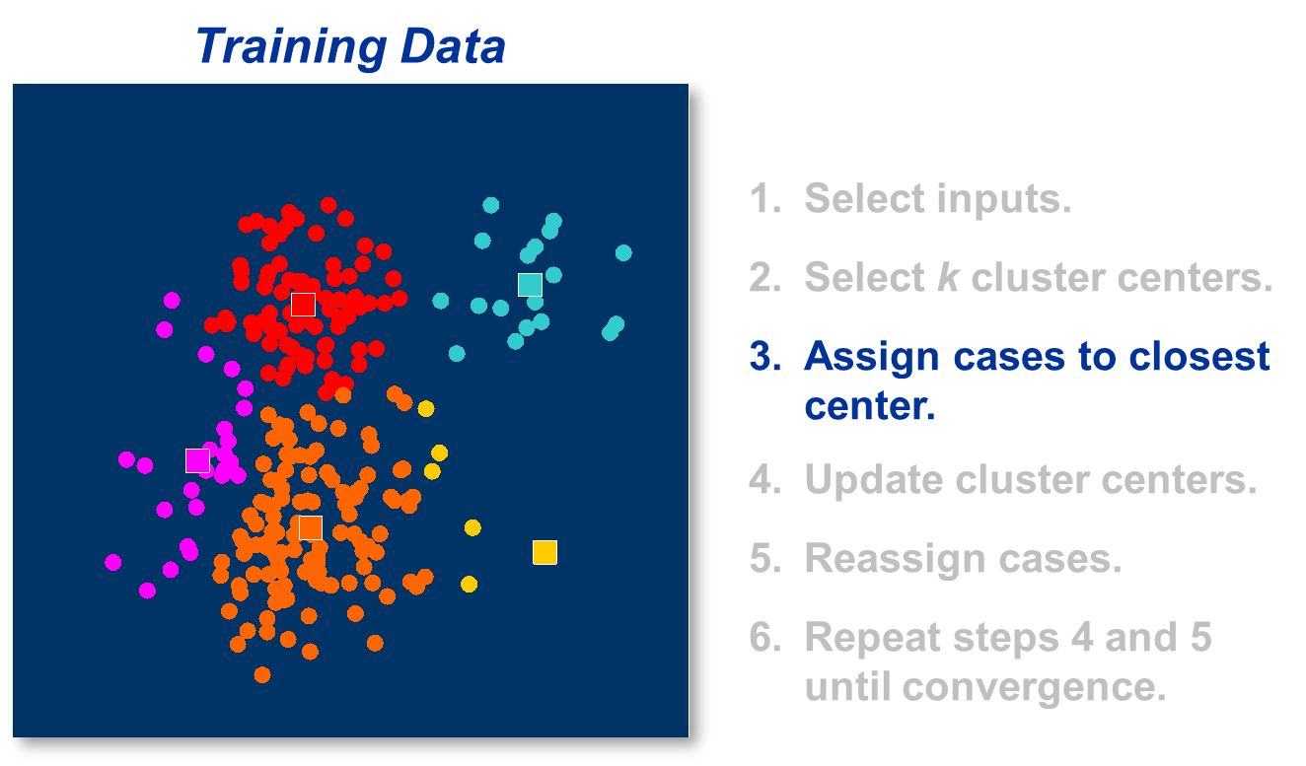
K-means clustering algorithm

Slide 6
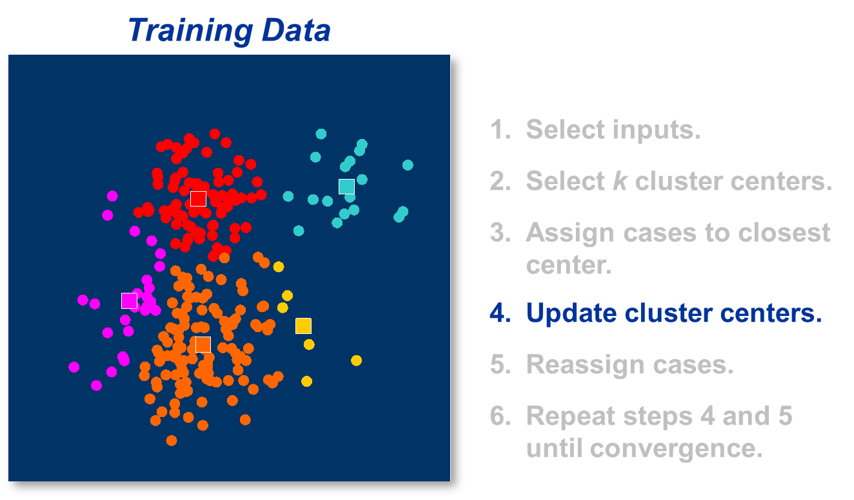
K-means clustering algorithm

Slide 7
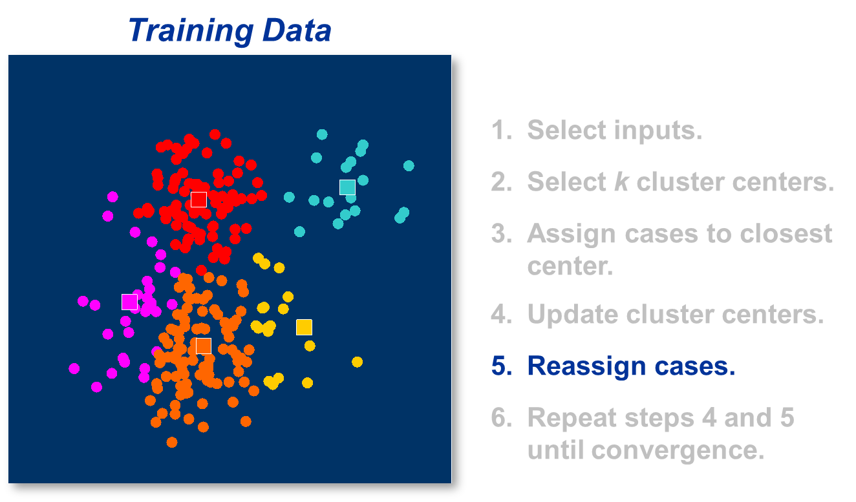
K-means clustering algorithm

Slide 8
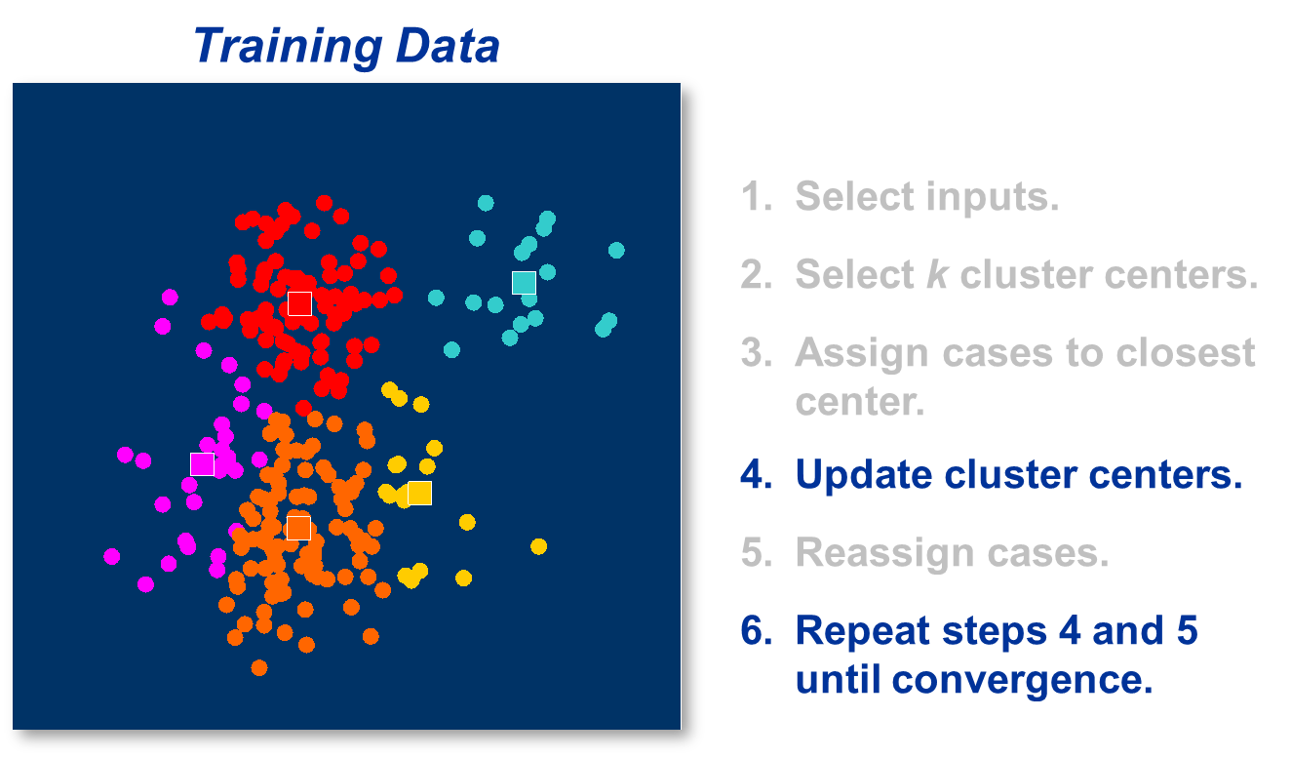
K-means clustering algorithm

Slide 9
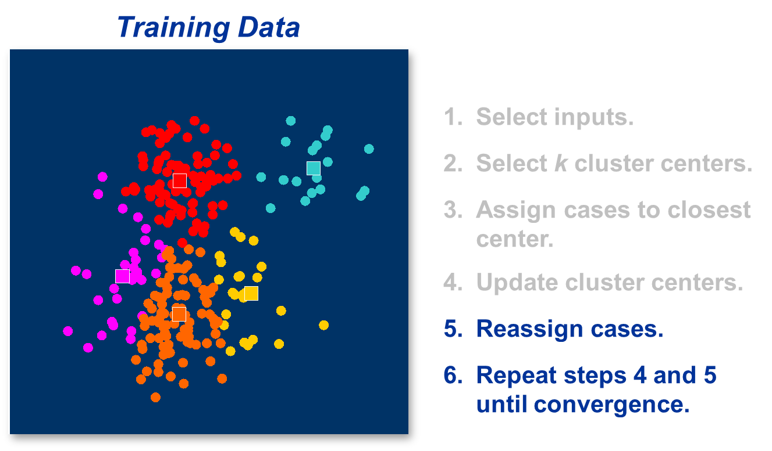
K-means clustering algorithm

Slide 10
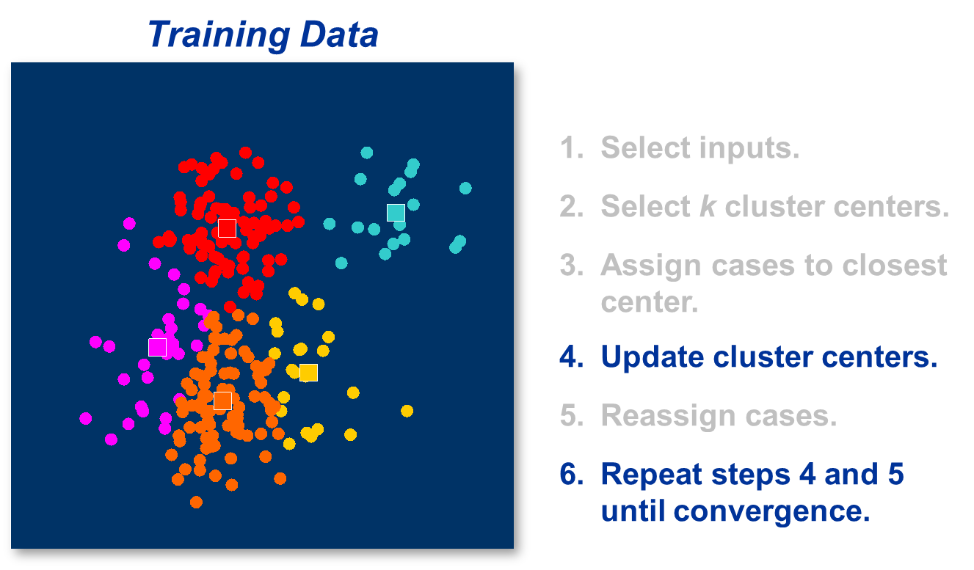
K-means clustering algorithm

Slide 11

K-means clustering algorithm

Slide 12

K-means clustering algorithm

Slide 13
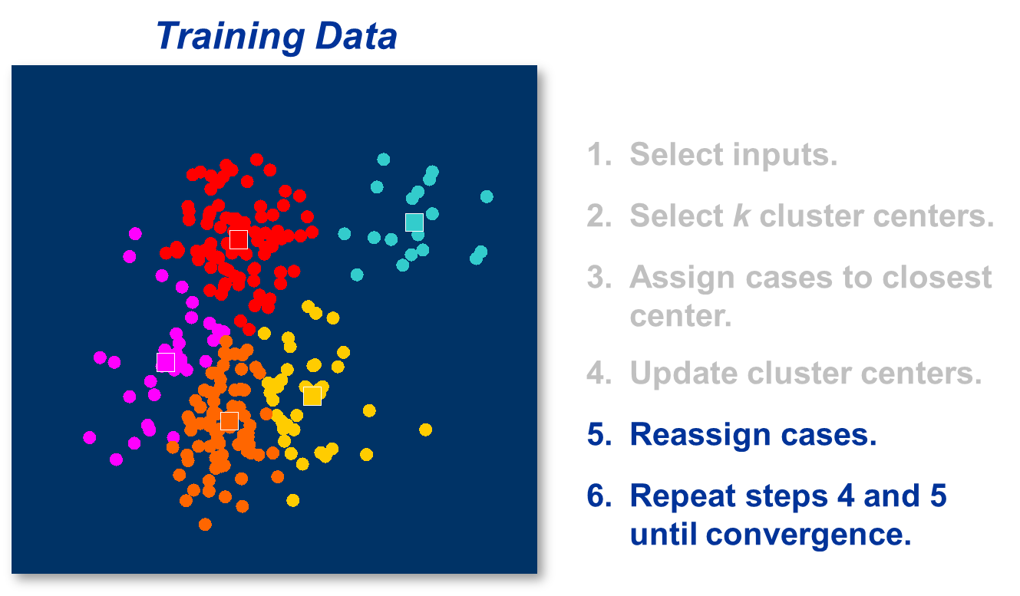
K-means clustering algorithm

Slide 14
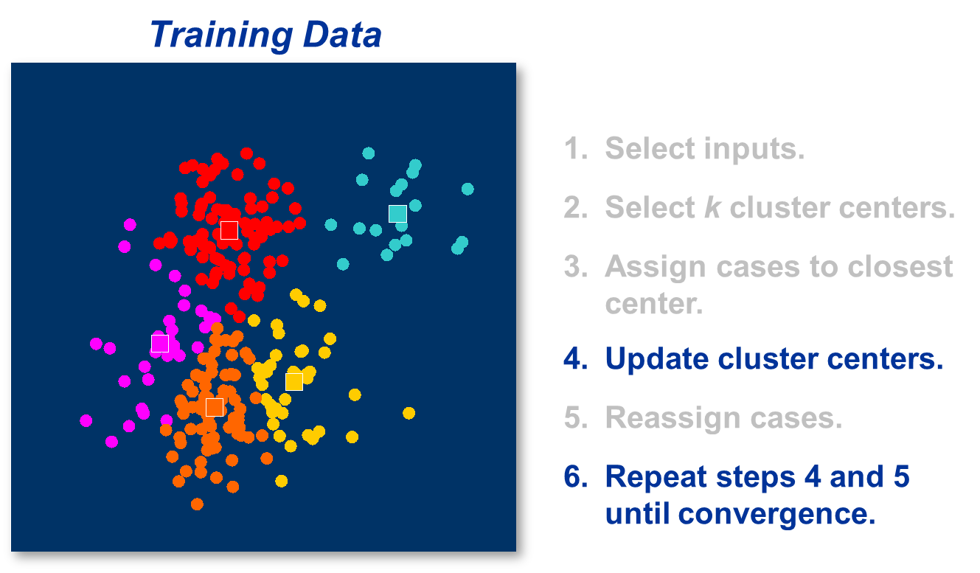
K-means clustering algorithm

Slide 15

K-means clustering algorithm

Slide 16
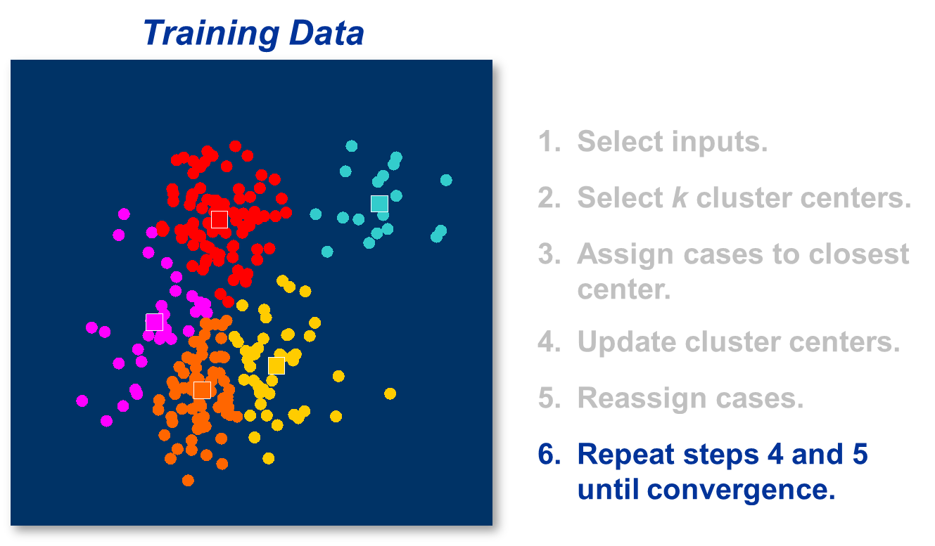
K-means clustering algorithm

Slide 17
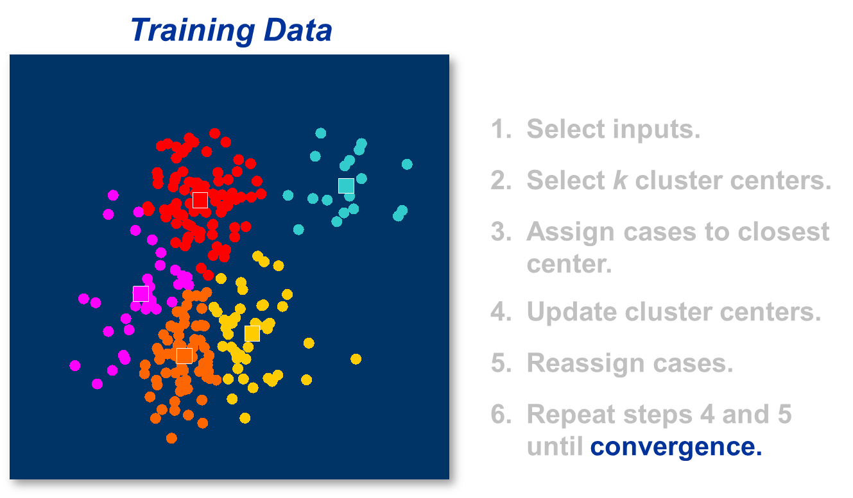
K-means clustering algorithm

Slide 18
Comments on the K-Means Method
The k-means method is relatively efficient in most cases. However,
Only applicable when mean is defined (what about categorical data?)
Need to specify k, the number of clusters, in advance
Has trouble with noisy data and outliers
Not suitable to discover clusters with non-convex shapes.

